Slide 1
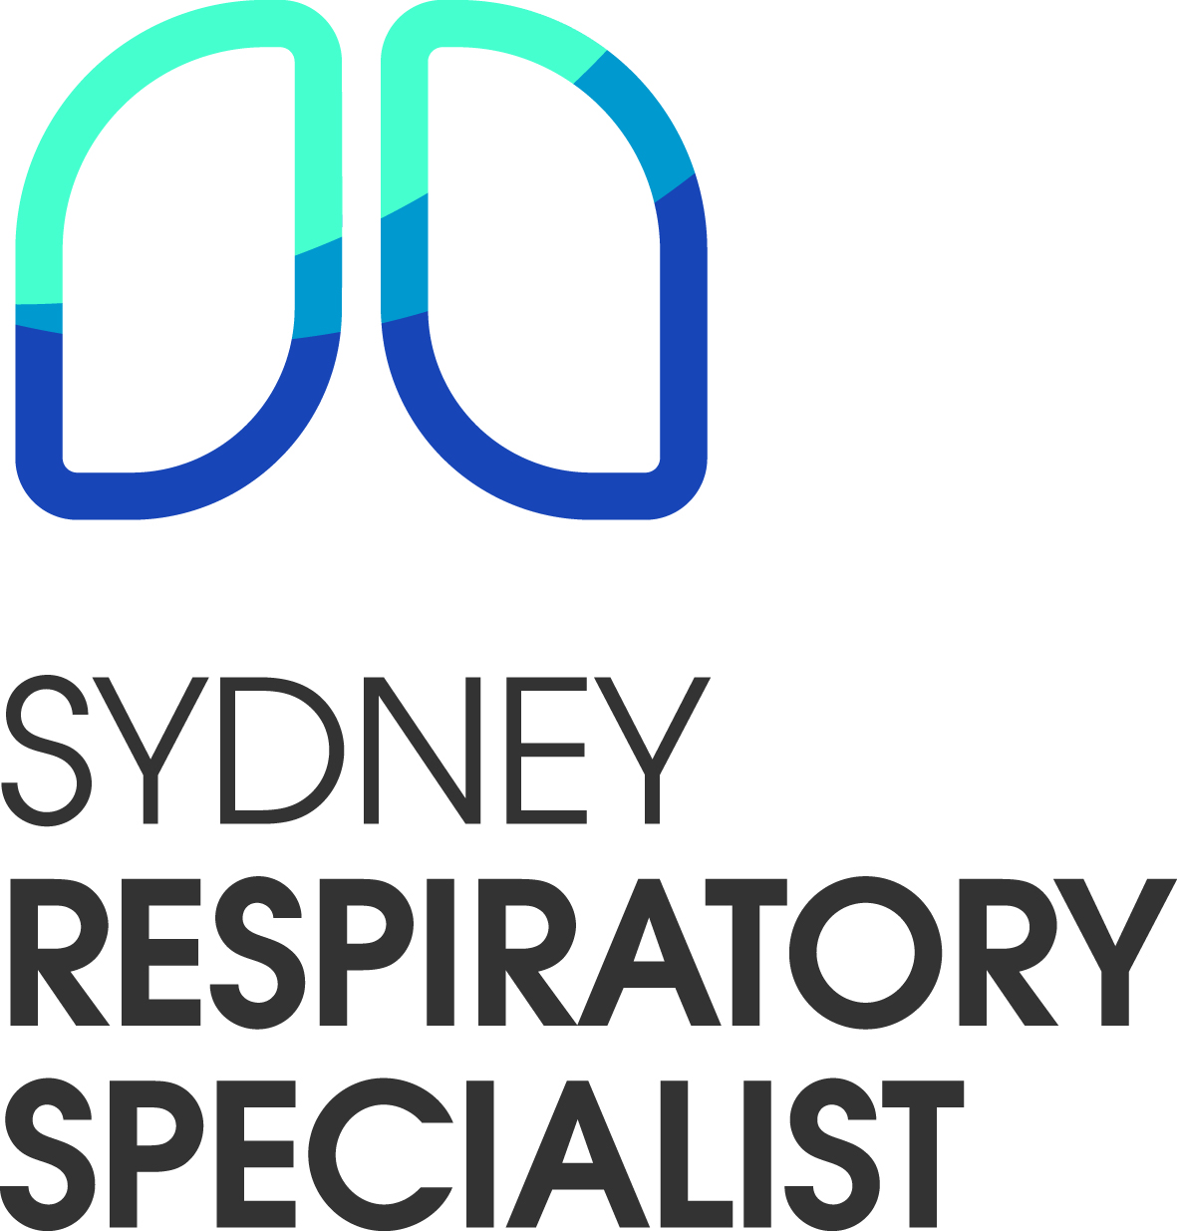

Sleep Apnoea in General Practice:
Recognise, Refer, Restore
Note the red flags in a sleep study
A/Prof Samantha Herath
Respiratory and sleep specialist
MBBS, FRACP, MPhil (sleep), PhD ( Interventional bronchoscopy)

Slide 2
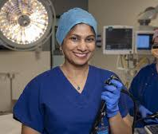
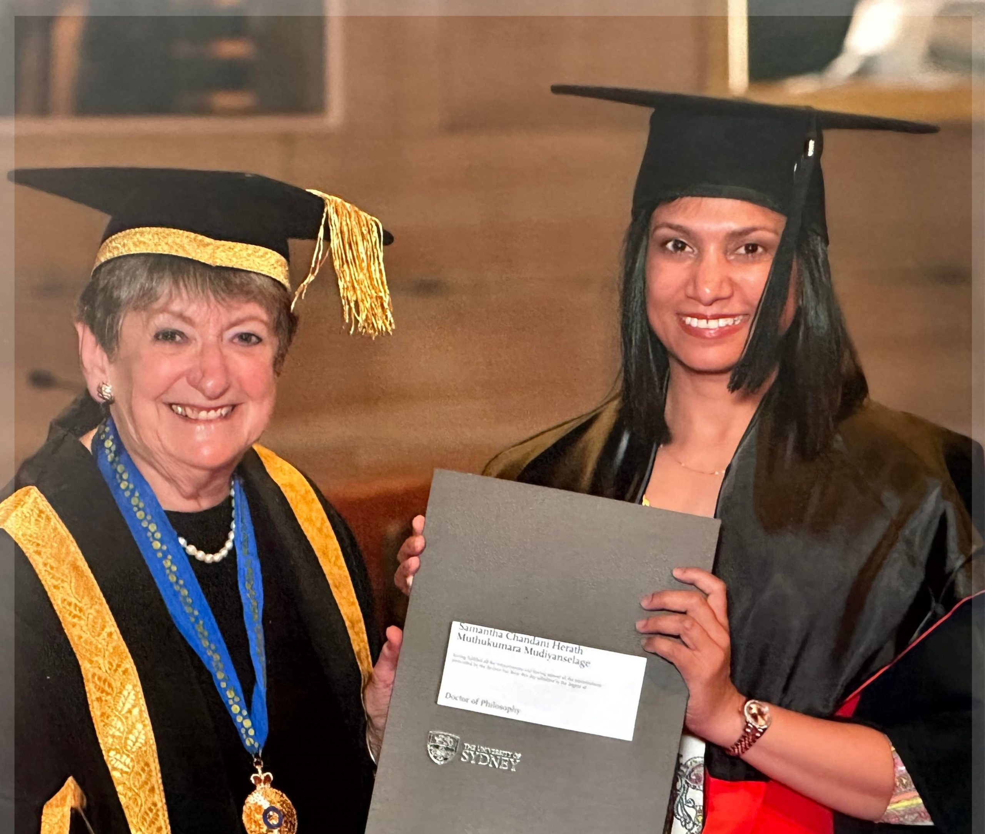
Background-
Dr Samantha herath
Respiratory and a sleep specialist for the last 13 years.
12-month fellowship in sleep medicine in Woolcock institute in 2012.
Masters in sleep medicine – University of Sydney.
Thesis – Vigilance in sleep apnoea
Level 1 sleep training with RACP- I can sleep report and manage CPAP patients.
2nd fellowship in advanced bronchoscopy in Canada
PhD is on interventional bronchoscopy (Usyd)
Thesis: Minimally invasive bronchoscopic lung nodule biopsy

Slide 3
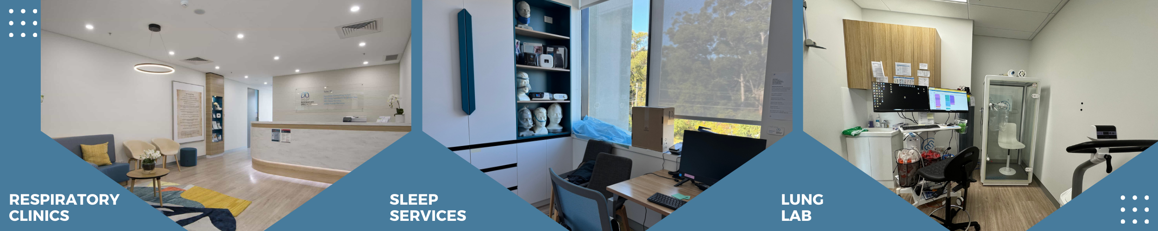
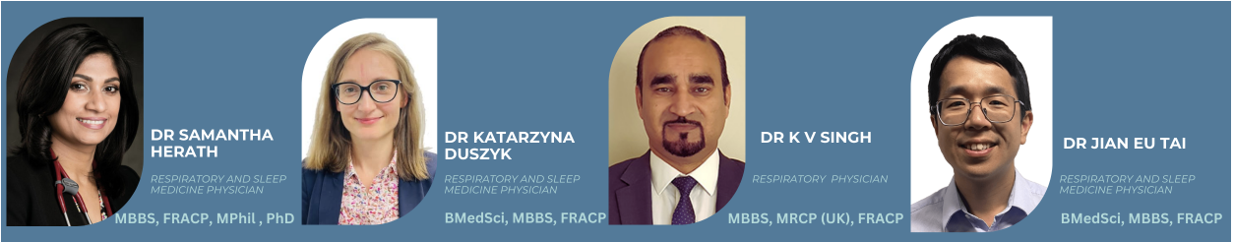
Our clinic –2017
Sydney Respiratory specialist clinic
Mission
Care exceeding expectation

Slide 4
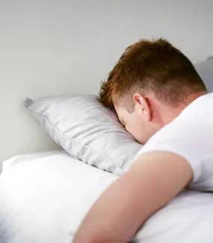
Today’s discussion
1. Undiagnosed epidemic of OSA
2. Atypical presentations
3. Red flags for screening
4. Myth busing session
5. Interpreting sleep studies
Discussion and feedback

Slide 5

1. Undiagnosed epidemic of sleep apnoea
1 in 4 people have OSA
1 in 3 people over 70 have OSA
As we live longer, we will see more patients with sleep apnoea
Sleep apnoea is the tip of the iceberg for many metabolic/Cardiovascular conditions.
( IHD/DM/GOUT/hyperlipidaemia, Hypothyroidism, low testosterone)
Sleep apnoea is often called the “silent partner” of cardiovascular disease.

Slide 6
2. Atypical presentations of OSA
Case study
Referral-
Main presentation: Nocturia
35 Y, Male, Anxiety, depression, Androgen deficiency, Panic attacks, PTSD, cervical spine degeneration, chronic pain.
BMI 33. ( 1/3 of Australia has a BMI >30)
GP suspected OSA- sent for review to us (OSA is a CLINICAL DIAGNOSIS)
Sleep study Home sleep study review 1
What are the red flags?
AHI
Nocturnal hypoxia

Slide 7
Atypical presentation of sleep apnoea
Nocturia
Daytime fatigue
Difficulty concentration
Nocturnal palpitations
Decreased libido/low testosterone
Anxiety/depression
Insomnia

Slide 8
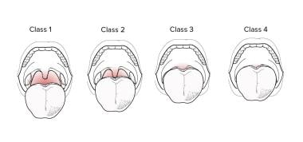
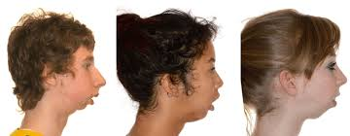
3. Red Flags for screening for OSA
HISTORY
Cardiovascular disease or resistant hypertension
Stroke/TIA history
Pulmonary hypertension
Atrial fibrillation or other arrhythmias
Type 2 diabetes
Depression, anxiety, insomnia
Obesity with fatigue or poor sleep
Family history of sleep apnoea
Nocturia (without daytime frequency)
EXAMINATION

Slide 9
OSA is a clinical diagnosis
Case study:
80Y, Male referred for chest congestion and pooling secretions behind his throat in the morning
Did not have “ the questionnaire diagnosis of OSA”.
STOP BANG 4
ESS 6/24
Referred to a sleep specialist
Home sleep study review 2
Red flags:
ATRIAL FIBRRILATION
Periodic limb movement-
Serum ferritin 15- needed iron replacement

Slide 10
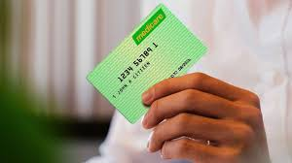
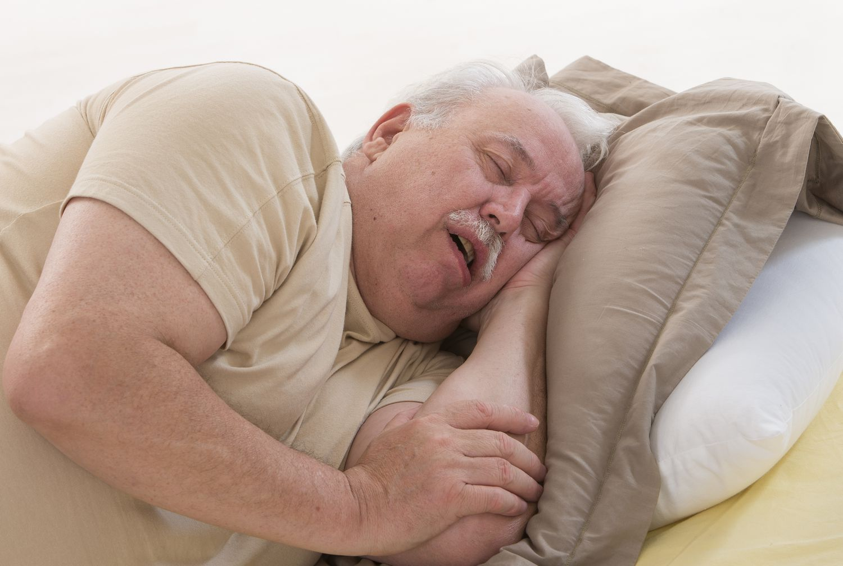
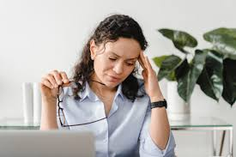
Clinical diagnosis
( It is not a questionnaire diagnosis)
Patients can score low in questionnaires and still have significant sleep apnea
Questionnaires are used to sieve out the “classic” sleep apnea patients- to fast track them.
Usually high BMI, male patients. E.g. truck driver
A sleep studies referred by a sleep specialist is always Medicare rebated- irrespective of questionnaire scores

Slide 11
MYTH BUSTING SESSION

Slide 12
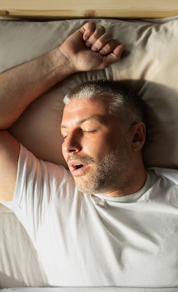
Myth 1
“I sleep fine” — I don’t have sleep apnoea”
Sleep apnoea and sleeping fine are two different things
30% of severe OSA patients have no daytime sleepiness
They just sleep through the hypoxia
Not just overweight men — women and normal-BMI patients can be affected
Tiredness may be the only sign of OSA
Review the sleep study

Slide 13
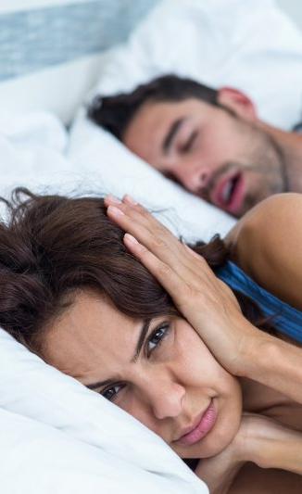
Myth 2-
My husband snores he MUST HAVE sleep apnoea
Snoring is a narrow airway causing turbulence.
Snoring and sleep apnoea can co-exist but snoring is not required for diagnosis of OSA
Snoring can be a problem by itself without any/significant OSA
A home sleep study can easily differentiate the two

Slide 14
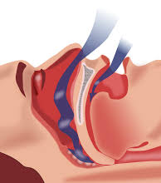
Myth 3
Correcting a deviated septum cures sleep apnoea
Doesn’t do anything to the actual sleep apnoea
Sleep apnoea is a down stream problem
Correcting a septum improves breathing quality. Can improve snoring.
Improves ability to tolerate a cPAP mask
Only UPPP and tonsillectomy, toung reduction surgery has any evidence

Slide 15
Myth 4
CPAP is the best treatment for severe OSA
Case study:
30Y , Male. sent by his GP to a provider for a sleep study- Tiredness
Sleep study 3rd party provider- Severe OSA AHI 33/h
The sleep studies from third party providers are reported by sleep specialist– who have not seen the patient
Therefore, suggest all possible treatment options
This patient had the treatment of CPAP suggested
Same third-party provider started CPAP
Didn’t improve- masks were changed-3 times
Didn’t improve- Increased the pressure of the CPAP machine from 8 to 18Cm H20 over few months.
Didn’t improve- upgraded the machine to an ASV (which he didn't need)
Then requested to use a BIPAP machine
He sees his GP-refers to our clinic-
one look it was obvious !

Slide 16
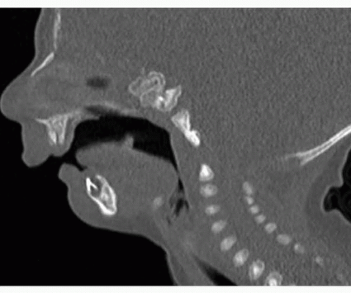
Severe Micrognathia
Red flags
A patient with severe OSA, never saw a sleep specialist
Started a medical device CPAP and continues to upgrade machines that are not indicated, without seeing a sleep specialist.
Cost to the patients was close to 3000 AUD/ 3 years
No improvement of symptoms.
In Sydney, every patient can see a sleep specialist in a timely manner for their sleep study and also to find the right treatment for them
There is no requirement to refer to third party nonmedical providers
Long term saves money, starts the correct treatment
Patient was referred for max facs surgery for a definitive management

Slide 17
Treatment for OSA
CPAP is not the only treatment option
Tailor treatment to the patient
CPAP is only one type of treatment
Options need to be tailored to the patient
Once commenced on CPAP- specially for severe OSA needs medical review to make sure the treatment is optimized
All commercial drivers need CPAP review yearly by a sleep specialist.
Lifestyle & weight management
Mandibular advancement splints
CPAP therapy
ENT ( UPPP or tonsillectomy)
Maxillofacial surgery for structural abnormalities
Adjunctive pharmacological options in select patients for weight management
Referral to a metabolic clinic/endocrine clinic (TFT/GH)
Referral to a Cardiologist – If not already done so

Slide 18
Myth 5
Treating sleep apnoea with CPAP always improves the daytime sleepiness
Case study:
40 year male presents with sleepiness
Diagnosed with “third party provider” with moderate OSA. starts CPAP-(never seen a sleep specialist)
Uses this for 4 years but sleepiness –when driving
Referred to our clinic by his GP
In lab sleep study on CPAP- to confirm adequacy (Review in lab sleep study)
Confirm adequacy of treatment
Daytime MSLT after nighttime CPAP (Review MSLT)
Diagnosed with Narcolepsy

Slide 19
All daytime sleepiness doesn’t improve with CPAP or other treatment for OSA
Some OSA patients do have residual sleepiness, may need an awake promoting agent in addition to CPAP
There may be a co existent second sleep disorder-that makes them sleepy
Narcolepsy,
Idiopathic hypersomnolence,
Nocturnal seizure disorders,
REM behavioral disorder
Parasomnia

Slide 20
Myth 6
Mild sleep apnoea doesn’t need treatment
The severity of sleep apnoea and the daytime fatigue are not linearly related
You could have minimal sleep apnoea but wake up every time you have an apnoeic event-making you tired
Home sleep study review 3
Treatment of OSA is done for 2 reasons
Severe OSA-Cardiovascular complications ( Irrespective of patient symptoms)
2. Symptomatic OSA –to improve quality of life (Irrespective of the severity of the OSA)
It is harder to treat patients who do not have symptoms

Slide 21
Myth 7
Sleep aponea in REM sleep or supine sleep position is not that important
Home sleep study review 4
Patents have better options with supine sleep- they can prevent it
REM stage- the cant change
Depends on the severity of OSA and symptoms of the patient

Slide 22
Myth 8
All patients diagnosed with severe OSA MUSt be reported to RMS
All commercial drivers need to be referred to a sleep specialist for conditional licensing and renewals
Private drivers-only if they had a crash due to sleepiness or has excessive daytime sleepiness ESS>12
The best indication for a future crash- is a past event
In NSW- self reporting of medical conditions encouraged
Austroads “Assessing Fitness to Drive” (2022 edition) regarding obstructive sleep apnoea (OSA) and fitness to drive:
"A person is not fit to hold an unconditional licence: if the person has an established sleep apnoea syndrome (sleep apnoea on a diagnostic sleep study and moderate to severe excessive daytime sleepiness); or if the person has frequent self-reported episodes of sleepiness or drowsiness while driving; or if the person has had motor vehicle crash(es) caused by inattention or sleepiness; or if the person, in the opinion of the treating doctor, represents a significant driving risk as a result of a sleep disorder."*

Slide 23
END OF MYTH BUSTING SESSION
Questions?

Slide 24
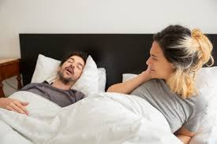
Problems with undiagnosed OSA-
Hidden hypoxia → cardiac strain, pulmonary hypertension, arrhythmias, right heart failure
Especially if the patient already has a Respiratory problem- much higher chance of nocturnal hypoxia
Autonomic surges → resistant hypertension (especially morning hypertension)
Poor quality of life
Partner fatigue
Home sleep study review 5

Slide 25
5 Take home messages

Slide 26
1. In a sleep study
Always check 5 things
1. AHI
2. Nocturnal hypoxia
3. Hypoventilation- needing an ABG
4. Heart rate and arrythmia
5. Daytime sleepiness- to decide on the driving-not just the severity of OSA

Slide 27
2. In a CPAP download – look for 3 things
Check for AHI
The number of hours the patient uses the machine for
Mask leak
Good CPAP treatment
AHI<10 best <5
Uses >4/h night
Acceptable mask leak

Slide 28
3. Screen for sleep apnoea in your patient
Refer your patient to a sleep specialist to do the sleep study
Your patient will receive the correct diagnosis
The correct study (in lab or in home) will be done
The correct leads ( extra limb leads, extra EEG) will be placed
The correct additional tests (ABG)
The patient will get a Medicare rebate-everytime –irrespective of the questionnaire
The sleep study will be reported tailored to your patient

Slide 29
4. Once sleep apnoea is diagnosed –
Refer your patient to a sleep specialist
Your patient will avoid incorrect treatment
Sleep apnoea is a medical condition
CPAP is a medical device and needs a medical specialist to oversee the CPAP use
CPAP is only one option of treatment
Treatment need to be tailored to suit the patient

Slide 30
5. OSA is treated for 2 reasons
Severe OSA
To prevent Cardiovascular complications
(Irrespective of patient’s symptoms)
Symptomatic OSA
To improve quality of life
(irrespective of severity of OSA)
Don’t disregard your mild OSA patients

Slide 31


Thank you -
Mitch- Sydney Adventist Hospital-organizing this meeting
Kelly- our practice manager - great service to our patients and local GP’s

Slide 32
Sleep Apnoea in General Practice:
Recognise, Refer, Restore
Thank you and questions? Prof Samantha Herath

